Slide 1
LOGISTIC
REGRESSION
Pena Benafa
pena.benafa@stud.hshl.de

Slide 2
Outline
Machine learning
What is regression
Regression Model
What is logistic regression
What is logistic function
Real life use case
Demo
Pros and Cons
Summary

Slide 3
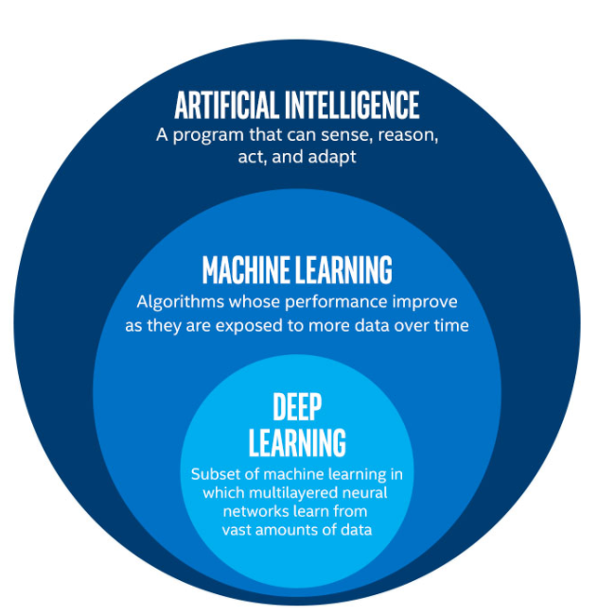
Machine Learning
What is ML?
A subset of AI
machines improves at tasks as it learns from experience
Improvement is enabled by the application of regression technique(s).
https://towardsdatascience.com/cousins-of-artificial-intelligence-dda4edc27b55

Slide 4
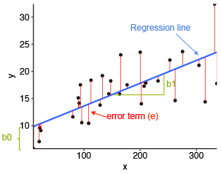
What is Regression
Predictive modelling technique
Estimates the relationship between a dependent variable (target) and an independent variable(predictor)
At any arbitrary value of X, the Y value can be predicted.
http://www.sthda.com/english/articles/40-regression-analysis/167-simple-linear-regression-in-r/

Slide 5
Regression Models
Linear Regression is used to predict the value of a variable based on the value of another variable
Logistic Regression is used to predict a binary outcome
Polynomial Regression is used to fit a non-linear equation to a data set
Linear Regression
Regression Analysis
Logistic Regression
Polynomial Regression

Slide 6
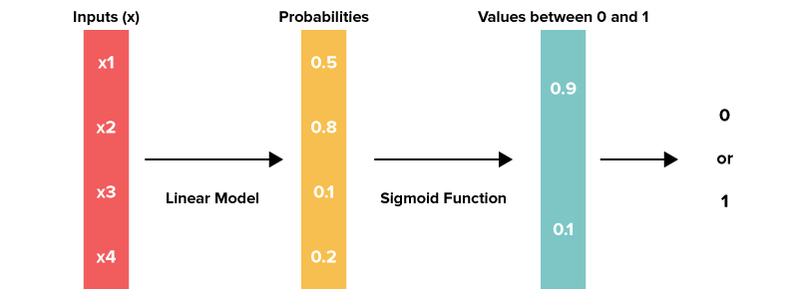
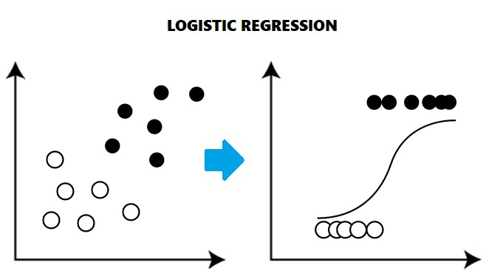
What is Logistic Regression
Uses a logistic function to measure the probabilistic relationship between two variables
Independent variables and
categorical (binary or multi-class) dependent variables.
Uses the maximum likelihood (Optimal way to fit a distribution to the data)
https://www.knowledgehut.com/blog/data-science/logistic-regression-for-machine-learning
https://www.equiskill.com/understanding-logistic-regression/

Slide 7
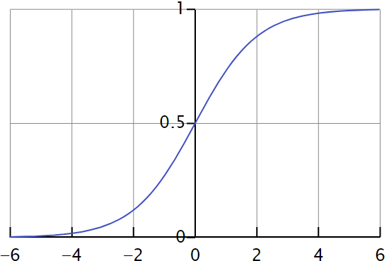
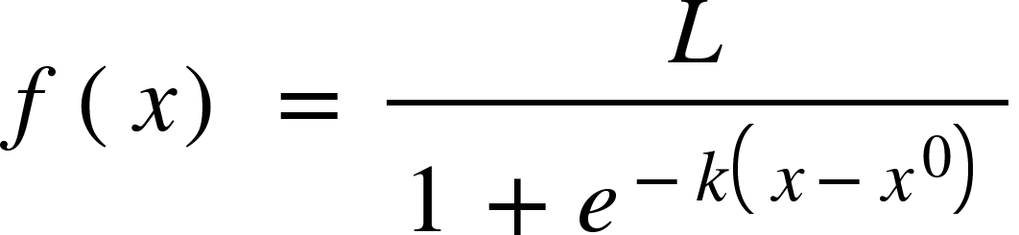
Logistic Function
L = curve’s maximum value
k = logistic growth rate
x = independent variable
x0 = value of x at sigmoid’s midpoint
Threshold value
Threshold value indicates the probability of winning or losing.
Above the threshold is approximated to 1
Below the threshold is approximated to 0
logistic regression tends it to limit the cost function between 0 and 1

Slide 8
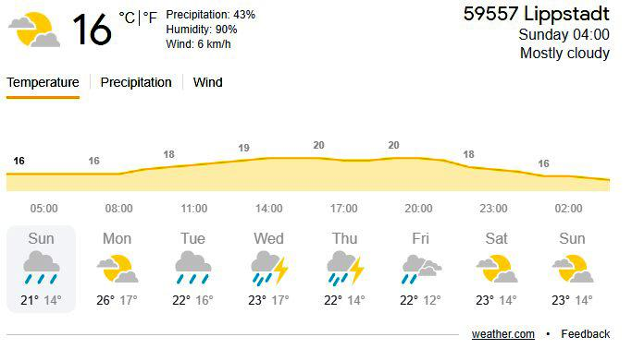

Real-Life Use Cases
Classification problem
Weather prediction

Slide 9

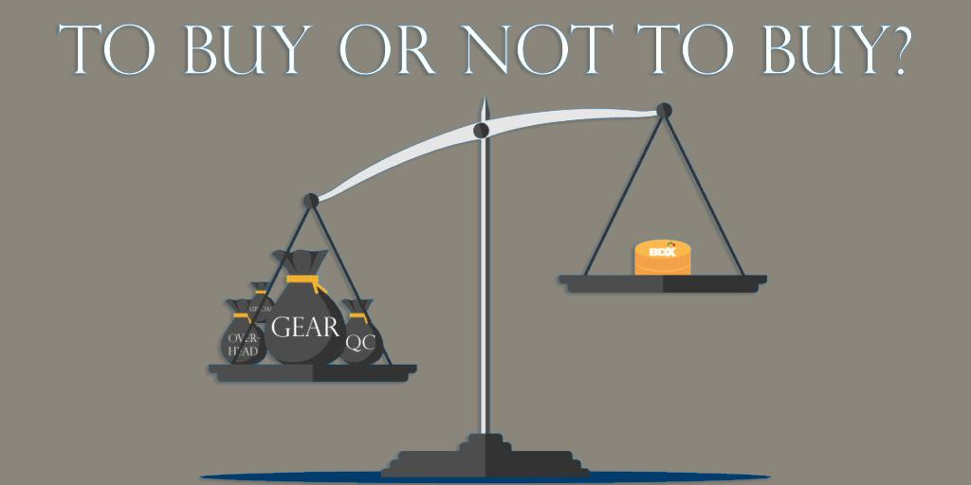
Real-Life Use Cases
Weather condition
Outcome of an event
https://helvar.com/can-lighting-aid-recovery-time-in-hospitals/
Accurate diagnose
https://researchleap.com/explaining-consumer-decision-making-process-critical-literature-review/

Slide 10
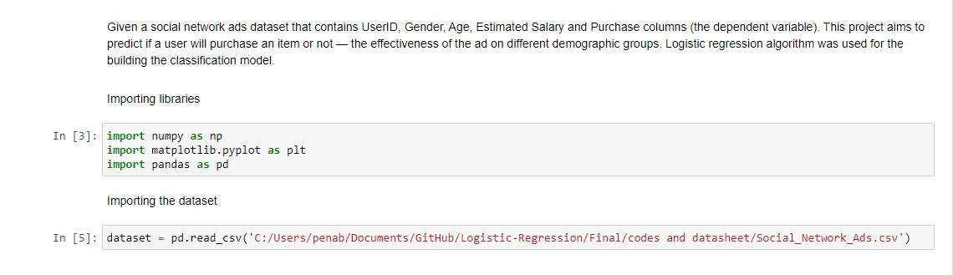
Demo

Slide 11
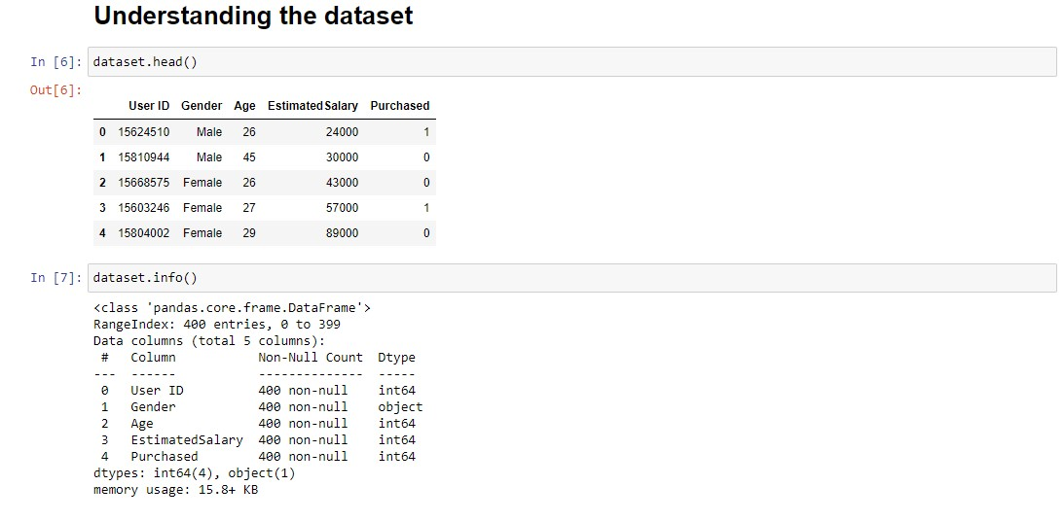
Demo Continue...

Slide 12
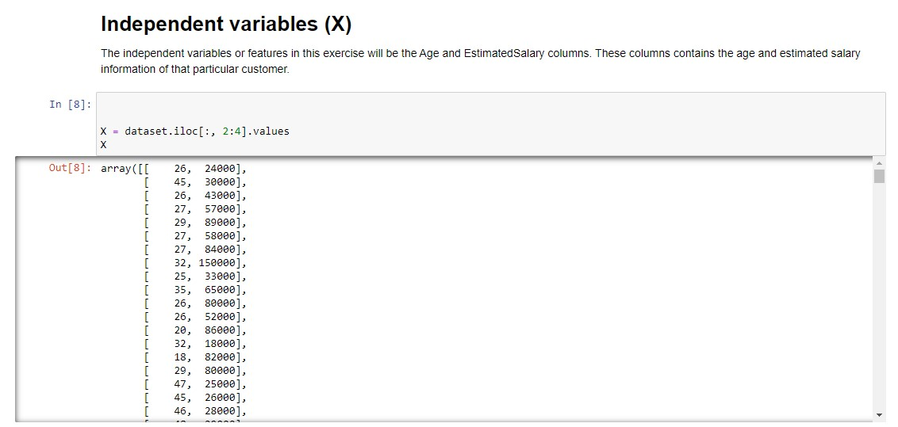
Demo Continue...

Slide 13
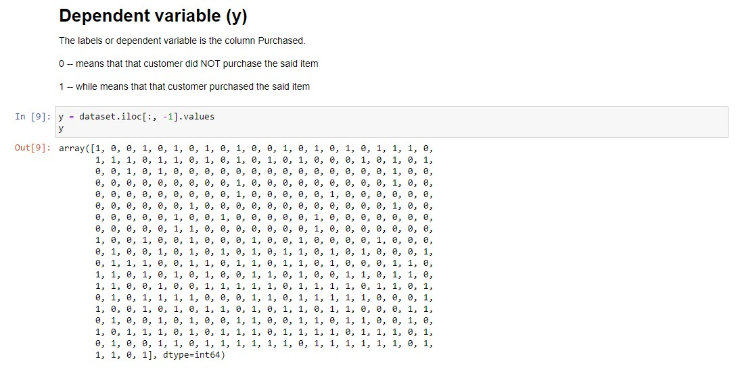
Demo Continue...

Slide 14
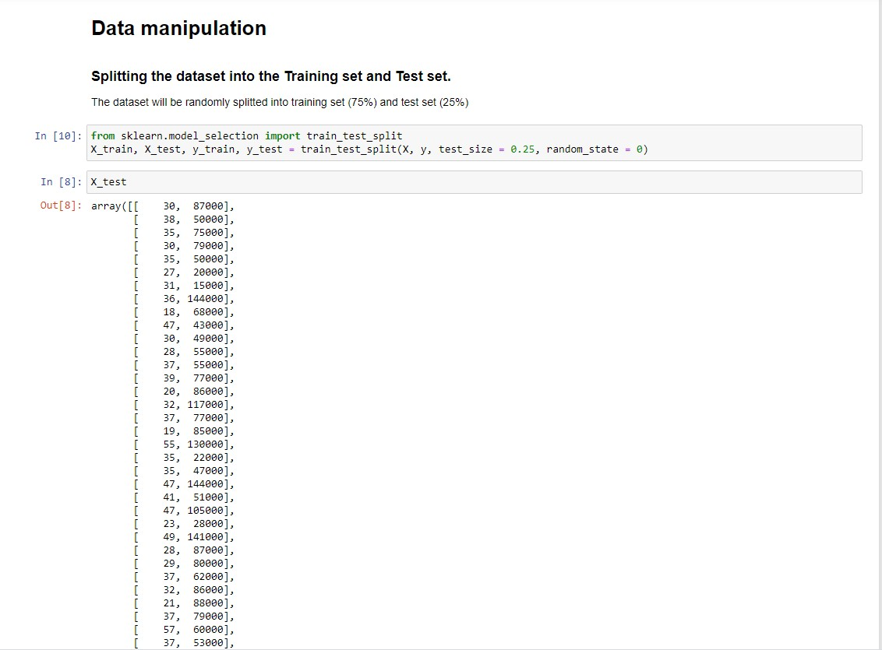
Demo Continue...

Slide 15
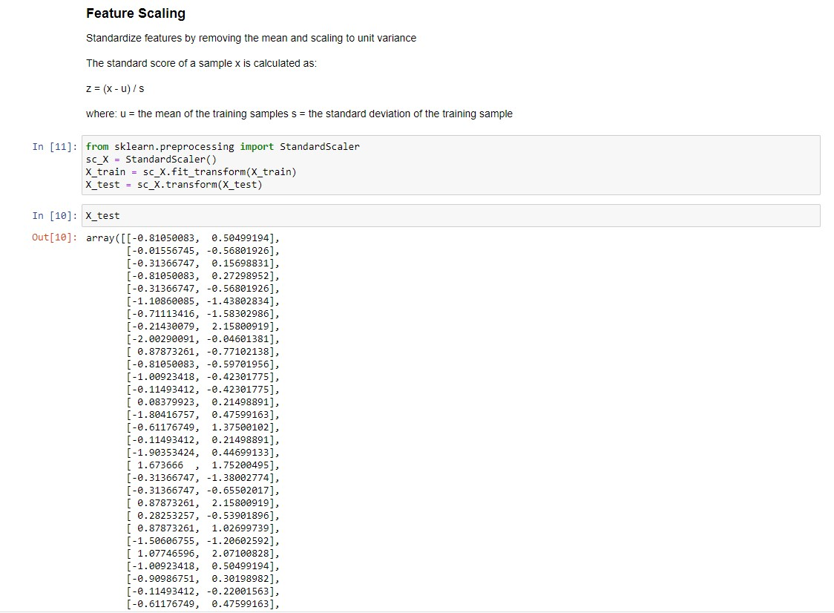
Demo Continue...

Slide 16
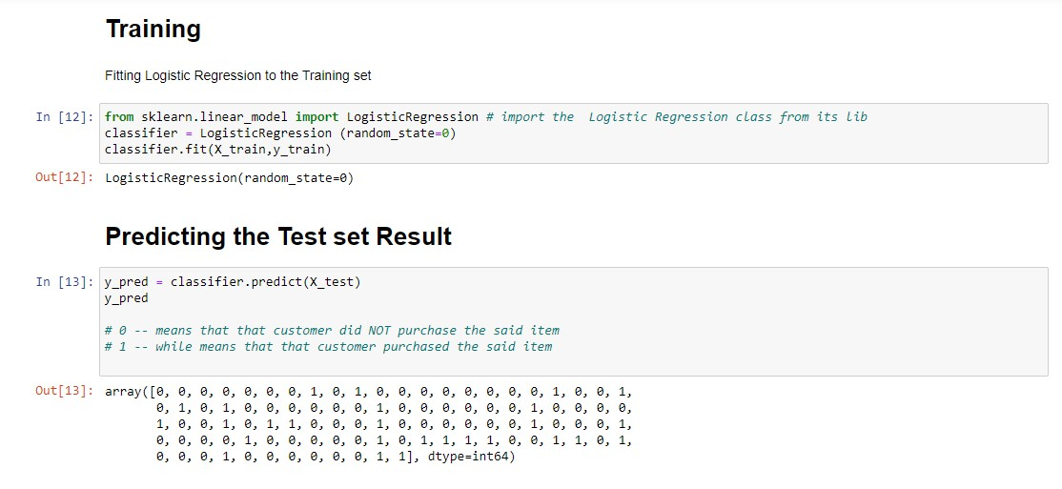
Demo Continue...

Slide 17
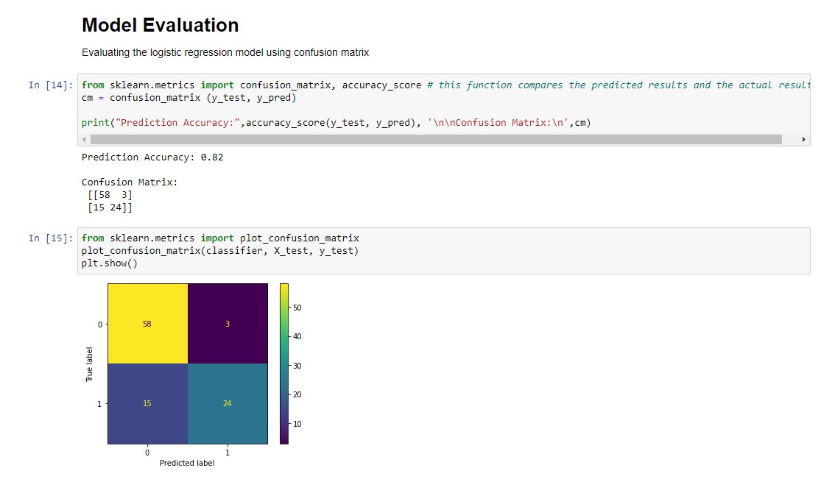
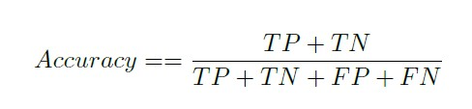
Demo Continue...

Slide 18
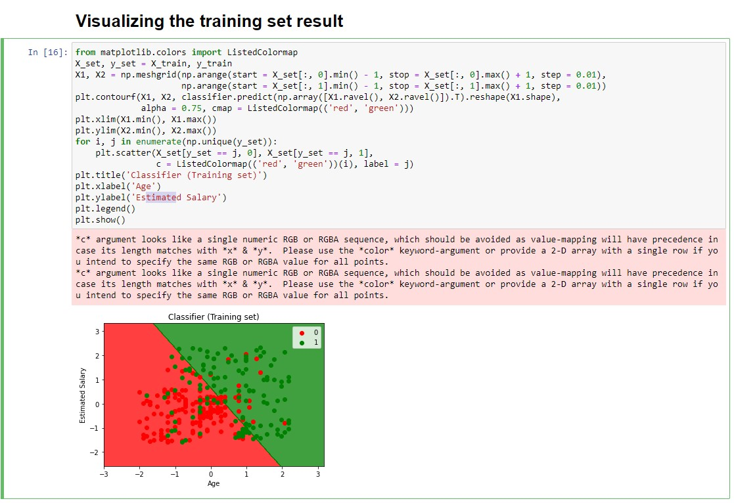
Demo Continue...

Slide 19
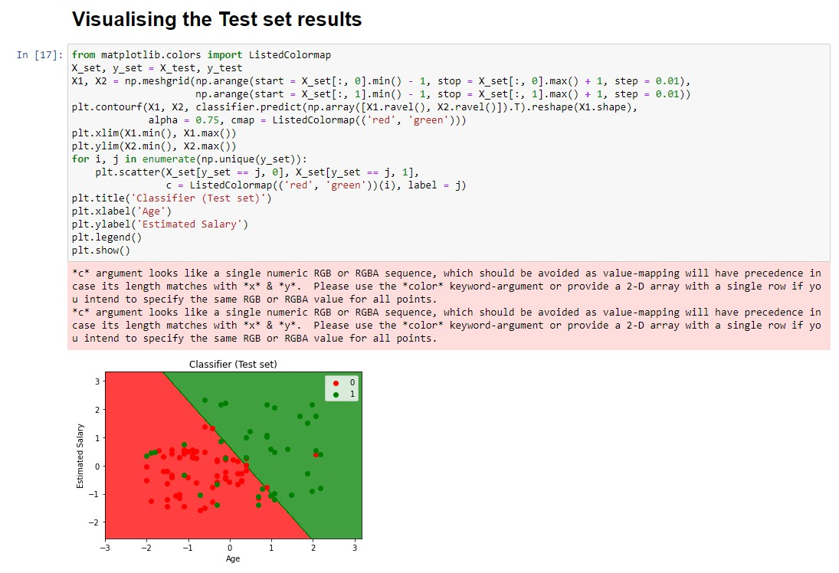
Demo Continue...

Slide 20
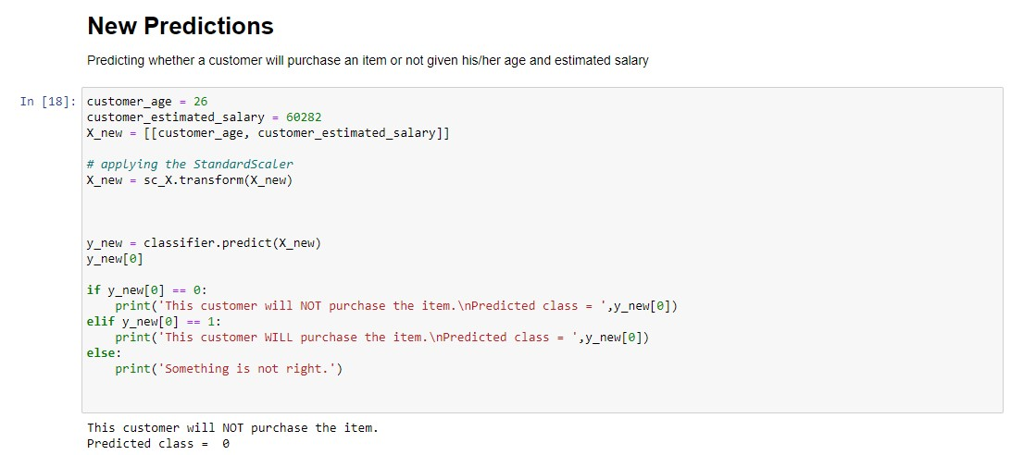
Demo Continue...

Slide 21
Pros and Cons
Pros:
Easier to Implement
Probability Prediction
Unlikely to Overfit
Large Dataset
Classification of Unknown Records
Cons:
Possibility of Under-fitting
Predicts Only Discrete Functions
Limited Use Case

Slide 22
Summary
Logistic regression is used to model the probability of a certain class or event existing such as pass/fail, win/lose, alive/dead.
The target variable always has to be categorical.
It is best used for classification problems

